Slide 1
Investing in Ethiopia:
The future pharmaceutical hub of Africa

Slide 2
Content
Background: favourable economic and political environment
Opportunities to invest in a high value pharmaceutical industry
tailored Incentives and support measures including a specialized park

Slide 3
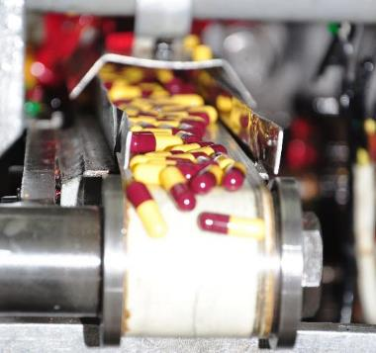
Strategic Investment Areas
Pharmaceutical Sector Opportunities

Slide 4
Strategic sectors have been identified for investment including the pharmaceutical industry
Today’s focus
Pharmaceuticals
Energy
Agro-processing
Tourism
Textile
Floriculture
Leather

Slide 5
One of the fastest growing economies with 9.68% average growth over the past 10 years.
Ethiopia has a clear vision for industrialization that builds from its rapid economic growth
One of the top destinations for foreign direct investment, standing 5th in Africa.
Productive labor force with more than 60% of its population between the ages of 15 – 65.
Dedicated leadership with a vision to become a manufacturing hub in Africa by 2025.
A member of preferential trade agreements and bilateral investment treaties - COMESA, EBA,AGOA, etc.

Slide 6
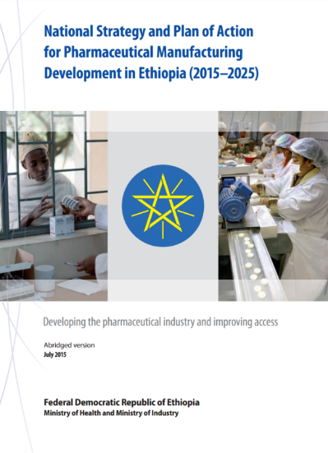
The GoE has identified Pharmaceutical as one of the priority sectors
Ethiopia is one of the first African countries to develop national strategy for pharmaceutical manufacturing
Strategy: To grow exports in addition to substituting imports and improving access to medicines
The Government will develop state of the art Industrial Parks specialized in pharmaceutical manufacturing
Dual benefit of increasing access to medicines and promoting rapid industrialization of the country
Goal: To become a pharmaceutical manufacturing hub in Africa

Slide 7
The Pharmaceutical manufacturing industry is nascent with a potential for growth
Ethiopia’s pharmaceutical sector market size
~ 4 B
USD by 2030
~ 1 B
USD by 2020
Mainly driven by:
One of the first African countries to develop a national strategy for pharmaceutical manufacturing
Strong investment policy focused on pharmaceuticals including tax exemptions, one-stop-shop services and price preference in public procurement
Potential to serve >$20 billion pharmaceutical market in Africa
Import-nearly 85%
12% of GDP to health (75% on essential medicines & services)
Out of pocket expenditure (46% of total expenditure)
Government’s 10 years expenditure for the sector (15B USD )

Slide 8
Ethiopian pharmaceutical market has been growing at 15% per year and was predicted to reach 1 billion by 2020
Pharmaceutical market in Ethiopia
(2015-30F), US$ million
5 years forecast
Local market has been growing steadily at an average of 15% per year
With growing population, increased access to health services and a growing middle-class, demand is projected to grow exponentially & reach >3.6 billion by 2030
Ethiopia currently imports ~85% of its pharmaceutical needs – a big gap that is yet to be fulfilled by manufacturing locally
Annual forecast
2015
2016F*
2017F
2018F
2019F
2020F
2025F
2030F
Note: *Forecast
Source: Frost & Sullivan, World Bank, National Strategy and Plan of Action for Pharmaceutical Manufacturing

Slide 9
Large & growing population and rising health care coverage make pharmaceutical manufacturing an attractive sector
Key drivers of pharmaceutical demand in Ethiopia
Second-largest population in Africa (>100M, ~8.5% of Africa’s population); growth of 2.3% per year is expected
With average economic growth of >10% per year, increase in disposable income will influence spending on pharmaceutical products
Growing population
Increasing healthcare coverage by government to the large rural population creates growing demand for pharmaceutical products.
Primary health care service coverage reached 100% in 2015
Awareness, diagnosis and treatment are increasing
High burden of communicable diseases: malaria, HIV/AIDS, TB
Prevalence of non-communicable diseases: diabetes, cancer, hypertension
Rising healthcare coverage
Source: Interviews, market research

Slide 10
There is access to market and Industrial Park (IP) designated for pharmaceutical sector
Advantages of manufacturing pharmaceuticals in Ethiopia
Focused Policies
Strong investment policy focused on pharmaceuticals which is led by Prime Minister Office
Tax exemptions: corporate income tax, personal income tax, duties, export taxes
One-stop shop for government services
Price preference in public procurement which accounts for a huge market
Specialized Industrial Parks
Kilinto Industrial Park (KIP) will be state-of-the-art and will specialize in pharmaceutical manufacturing
Land lease rate for KIP is 3.59 USD/m2 p.a. for 40 years.
Access to market
Potential to serve as export hub for the >$20 billion pharmaceutical market in Africa
More regional markets through economic communities including COMESA and IGAD progressing towards regulatory harmonization.
Abundant workforce
More than 10 schools of pharmacy in Ethiopia
Expanding programs to new areas of specialization (e.g. industrial pharmacy, pharmaceutical analysis, etc.)
Centres of Excellence are being established to offer these specializations
Source: Interviews, market research reports

Slide 11
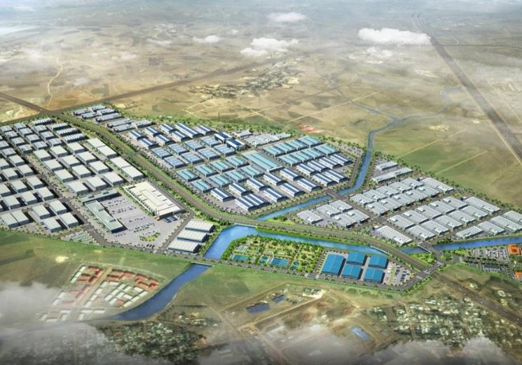
Kilinto Industrial Park is the first IP specializing in pharmaceuticals
Location
Addis Ababa; 25 km from city center, 863 Km from Djibouti port and 10 minutes drive from Bole International Airport
Population and employment
+4 million people live in the city
Accessible to skilled labour
Industrial park area
Established on 279 ha of land
177 ha service land for manufacturing
Land is available at reasonable lease prices
Industrial park facilities
Health Center
Police Station
One-Stop Shop Services
Commercial Building
Fire Brigade & 24/7 Security Services
Waste Treatment Facilities

Slide 12
…….
Industrial park key characteristics
Located along strategic economic corridors, connected to ports by electric driven railway lines and asphalt roads with Close proximity to abundant labor force
Ready for plug-and-play, equipped with all the necessary infrastructure including waste water treatment plants with joint calibration
Dedicated power with own sub-station and state of the art waste treatment facilities with a dedicated park administration and support system
Health stations, fire brigade, expats accommodation and 24 hours security services
One Stop Services (OSS) including processing & issuance of permits, licenses, registration certificates, agreements, tax identification number, customs clearance, banking services.
SECTOR
SPECIALIZATION
EXPORT ORINTED
VERTICALY INTEGERATED
SUSTAINABILITY
SKILL DEVELOPMENT

Slide 13
Proactive business environment – tailored incentives and support
Fiscal Incentives tailored to investment
Non-fiscal Incentives tailored to investment
Industry support targeting manufacturers
Miscellaneous
Exemption from income tax up to 14 years for APIs manufacturing and up to 12 years for Formulation/final product manufacturers,
Exemption from duties and other taxes on imports of machinery, equipment, construction materials, spare parts, raw materials and vehicles
Personal income tax exemptions up to 10 years for professionals working in R&D
Loss-carry forward
Full export duty exemption
Customs facilitation through bonded export factory and similar other schemes
Guarantee against expropriation
Guarantee for repatriation of funds
Relaxed Industrial park land regime - 60-80 years charge-free lease for IP Developers, discounted lease rate for IP Enterprises
Public procurement: 25% price preference and 30% prepayment for government contract winners,
Potential for long term procurement guarantee.
Fast-track medicine registration
Regional regulatory harmonization underway to catalyze regional trade
Expedited visa procedure - expedited procedure of securing entry, work permit and certificate of residency
Multiple entry visas for share holders and general managers
Facilitation of market linkages
One-Stop Shop Service under the EIC - including pre-establishment licensing and registration and post-establishment after-care services

Slide 14
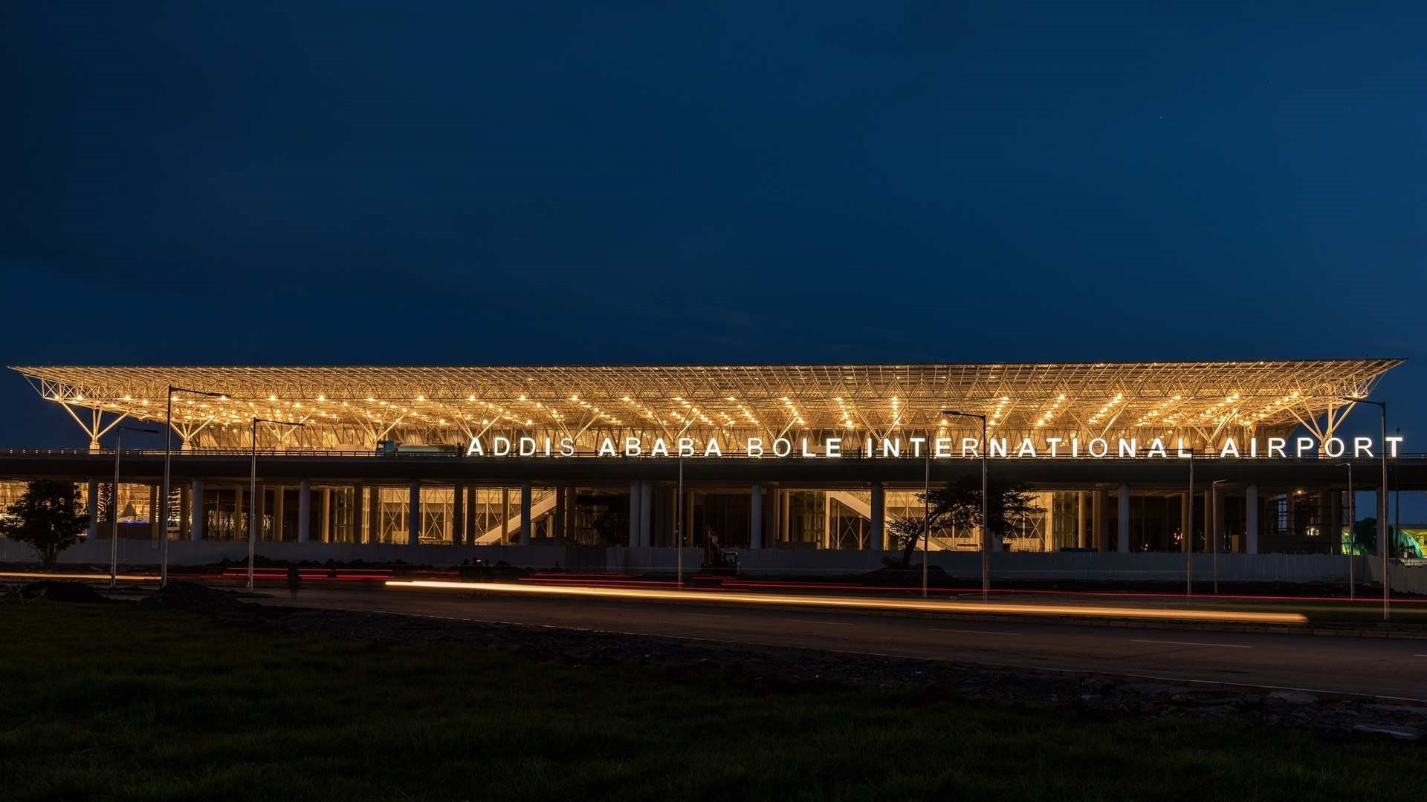
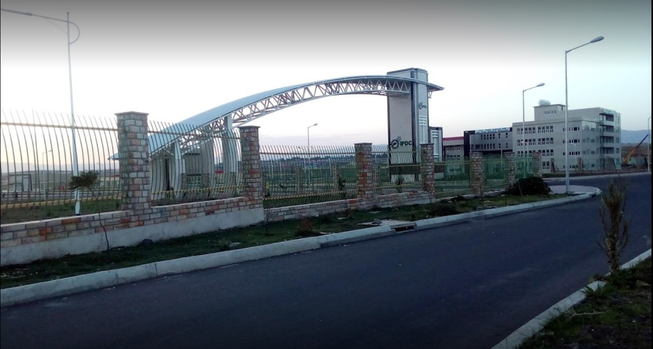
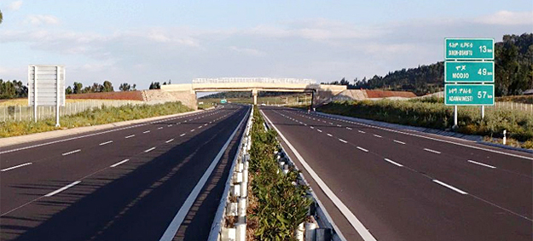
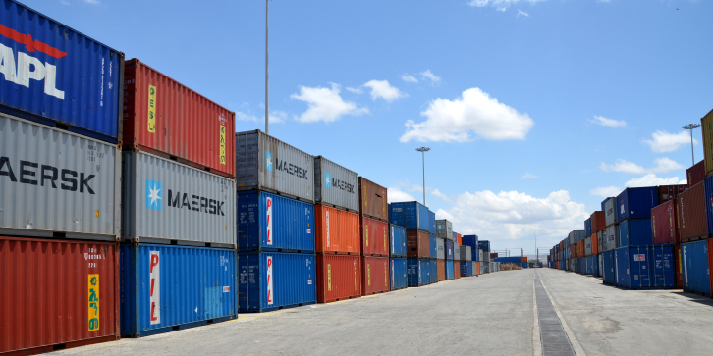
10 minutes drive from Addis Ababa International Airport.
35 minutes drive to Modjo dry port through the expressway.

Slide 15
THANK YOU!

